Slide 1
IoT Heat Risk & Climate Adaptive Safety System (HRCAS)
IoT system monitors temperature and alerts when dangerous heat is detected.
By: Mariam, Masa, Nakai, Hamna

Slide 2
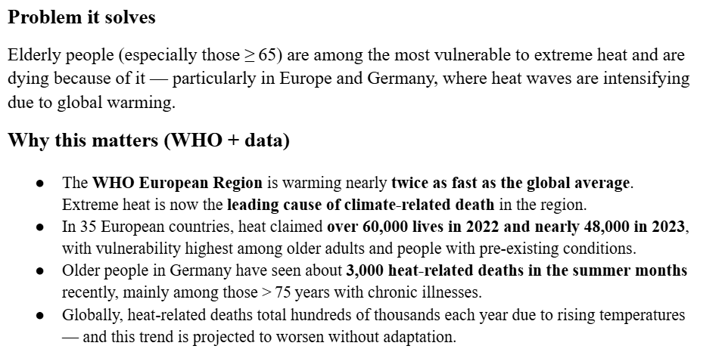
What is the problem?
Elderly vulnerable to extreme indoor heat
Manual monitoring is unreliable
IoT provides continuous monitoring and automatic alerts

Slide 3
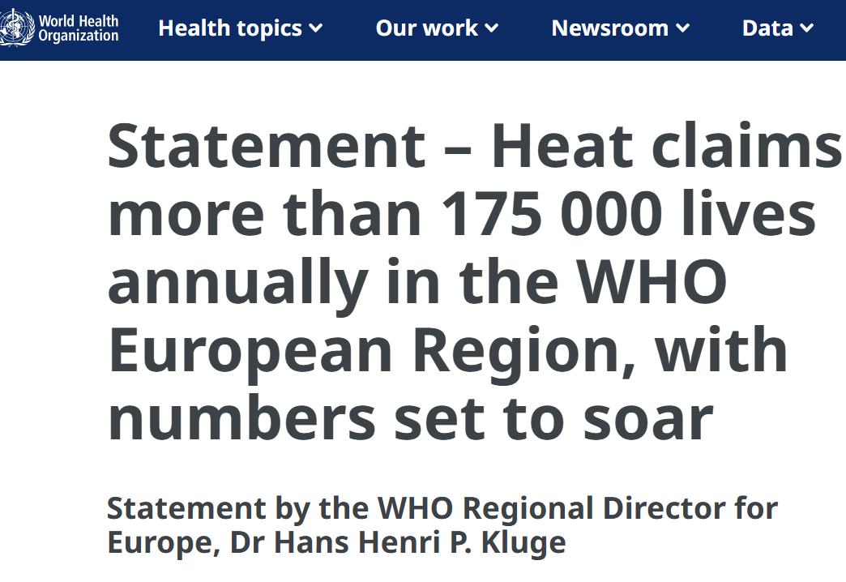
Why this is relevant?
Heatwaves Euro

Slide 4
Our solution
• IoT-based monitoring and alert system designed to prevent dangerous indoor heat conditions in elderly care environments.
• PHASE 1: It continuously tracks the state of the environment in real time and determines when temperatures get dangerous.
•PHASE 2: The system detects a heat risk, sends out instant alerts, and starts automatic safety measures.
It also allows for remote monitoring, which enables caregivers to act swiftly and guarantee resident safety.

Slide 5
Solution Architecture
Perception layer DHT22 + OLED + LED + RELAY
Network layer ESP32 processes temperature data + edge via WiFi
Application layer sent via MQTT for ThingsBoard cloud monitoring

Slide 6
Data Flow & Logic
ESP32 reads sensor data
Checks temperature threshold
If unsafe → LED ON, relay activates
OLED displays alert, MQTT sends data

Slide 7
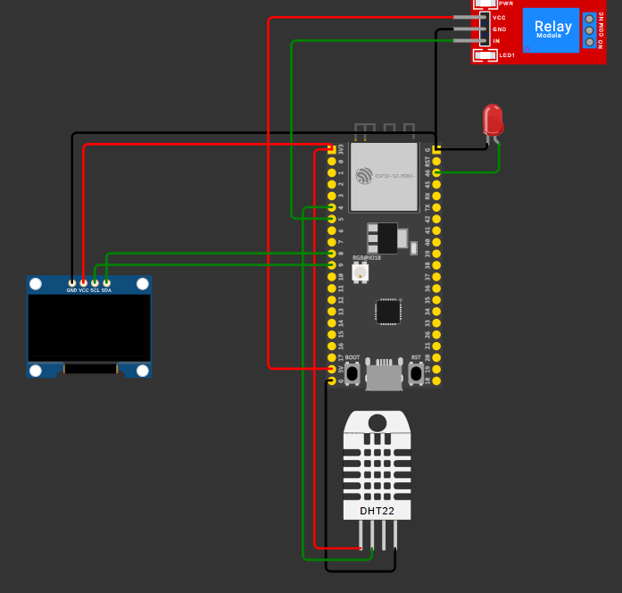
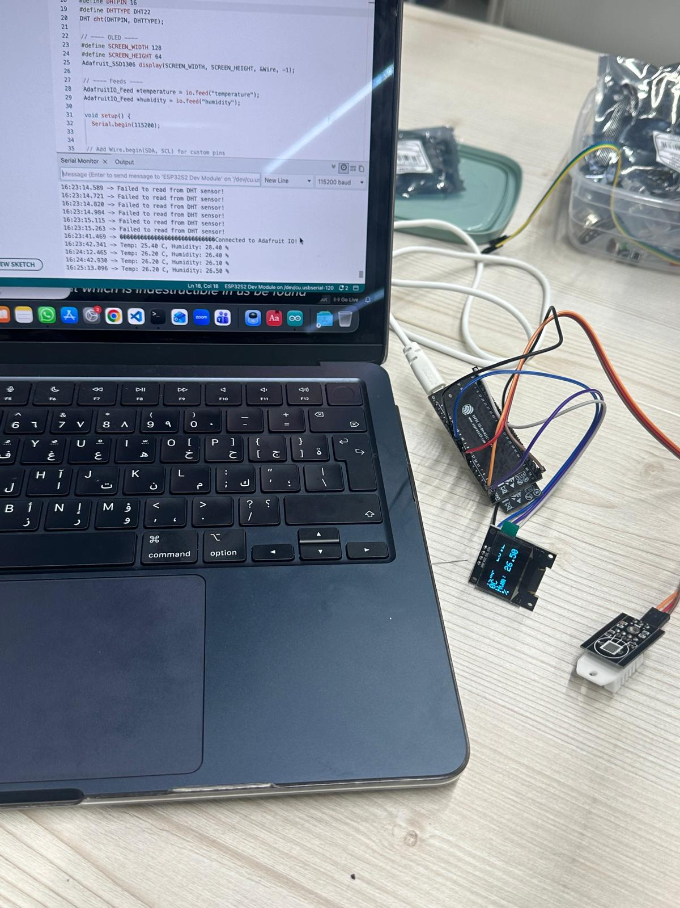
Hardware & WOKWI Simulation

Slide 8
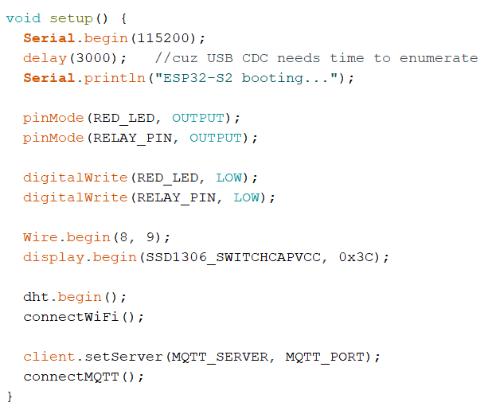
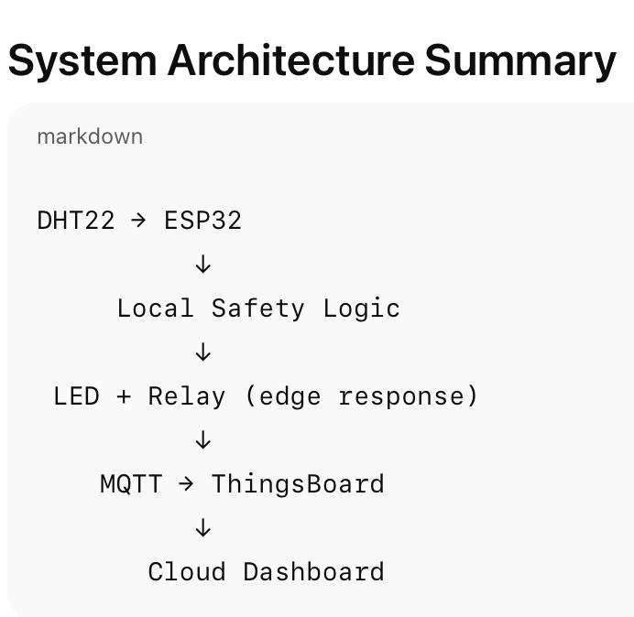
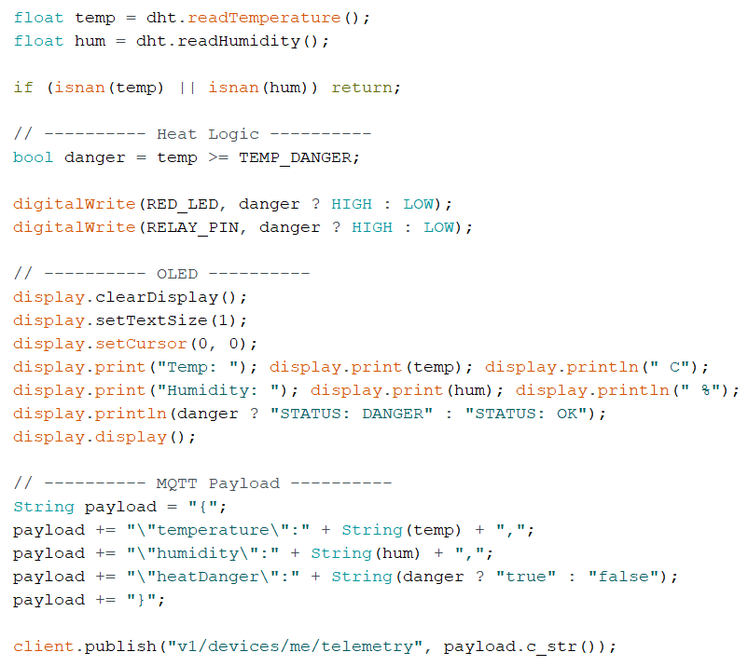
Code Structure
Setup: initialize Wi-Fi, MQTT, sensors, OLED
Loop: read sensors, check safety, update alerts
Modular functions used

Slide 9
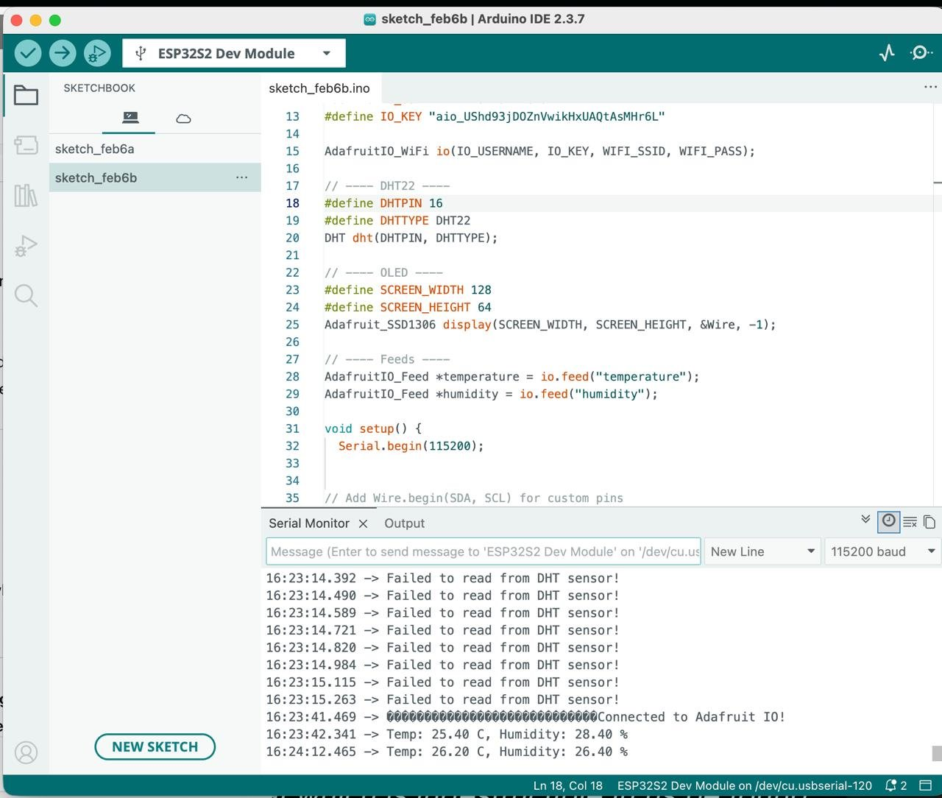
RAW real time Data on Arduino

Slide 10
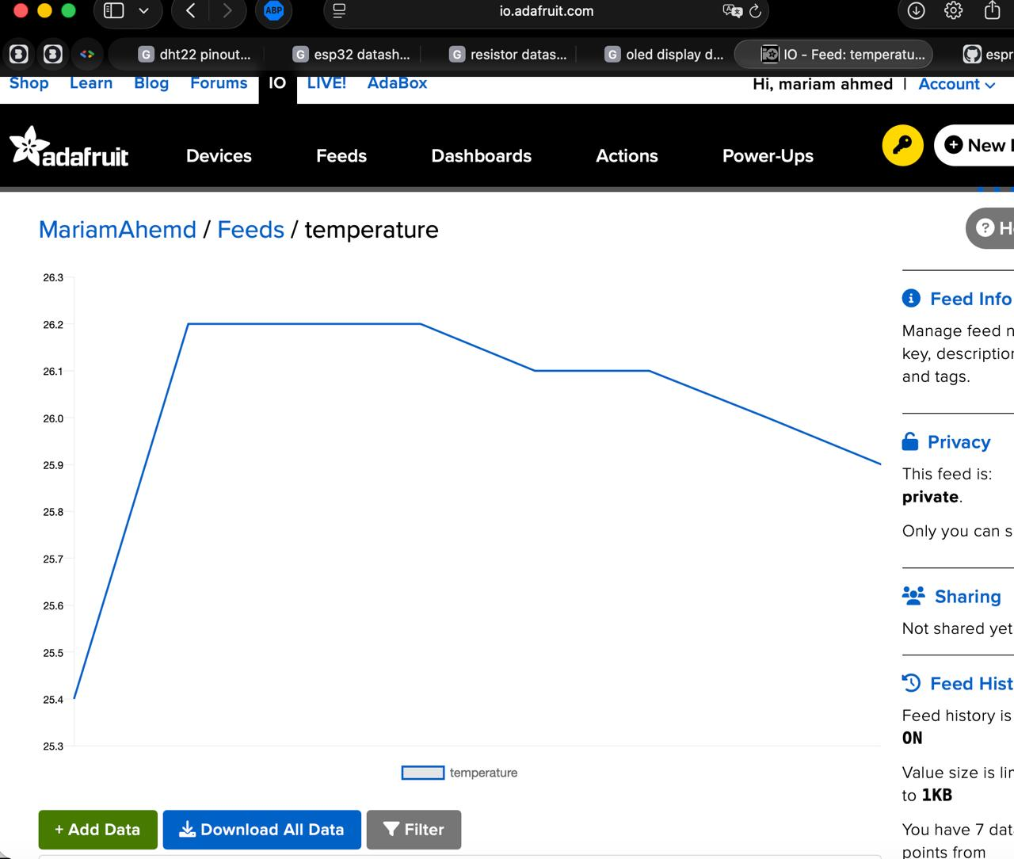
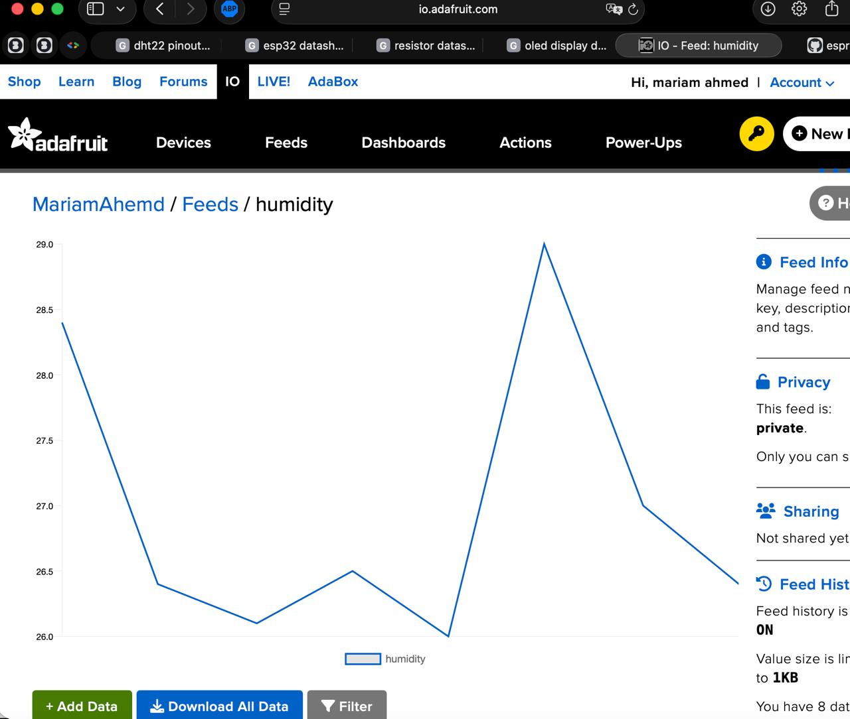
Temperature and Humidity graph test on Adafruit

Slide 11
UI & Live Data
Phase 3 additional expansions
Read-only real-time monitoring dashboard
Displays temperature, humidity, and heat risk
ESP32 → MQTT → Dashboard (live updates)
No page refresh required
Designed for supervisory monitoring

Slide 12
Intelligent Alert Handling (UI Side)
Phase 3 additional expansions​
Priority: Danger overrides Warning (one clear message)
Multi-room summary: “Danger in rooms 01 and 02” (not repetitive)
Cooldown timer: prevents alarm spam and overlapping announcements
Audio triggers only on state change (escalation), not when cooling down

Slide 13
Alert System
Phase 3 additional expansions​
Automatic Warning & Danger detection
Color-coded visual risk levels
Voice alerts with:
Priority (Danger > Warning)
Deduplication
Cooldown (no spam)
Handles multiple rooms safely

Slide 14

Challenges we faced
Networking issues, ESP32 needs Wi-Fi
Unavailable components, restricted resources
Incompatible ESP version on Arduino
Packages and dependencies installation

Slide 15
Future improvements
Adding sensors like: Ultrasonic and PIR
Focusing on Power Optimization, including a battery backup to monitor multiple rooms
Upgrade to 8883 MQTT for secure communication
Creating a Machine Learning model for future predictions
Integrating a relevant agentic RAG system for
Dashboard customisation and expansion

Slide 16
Industry Relevance
Useful in nursing homes and hospitals
Prevents heat-related risks
Supports smart healthcare systems

Slide 17
Thank You

